Slide 1
Final Project
IS362
Kou Omori

Slide 2
Quote
“What most people don’t know is that the [Best Picture and Best Film Editing] are highly correlated: since 1981 not a single film has won Best Picture without at least being nominated for Film Editing. In fact about two-thirds of the cases of movies nominated for Film Editing has gone to win Best Picture.
- Greg McKeown, 2014
Interpretation – “In how many years, did Nominated Film-Editing pictures win Best-Picture.

Slide 3
Data Used
There are many incomplete data sources available online.
https://www.kaggle.com/datasets/theacademy/academy-awards?select=database.csv
https://data.world/annemariedufour/academy-awards-and-ethnic-diversity-representation/workspace/file?filename=academy_awards.csv
Most are poorly formatted or have incorrect data.
https://www.aggdata.com/awards/oscar

Slide 4
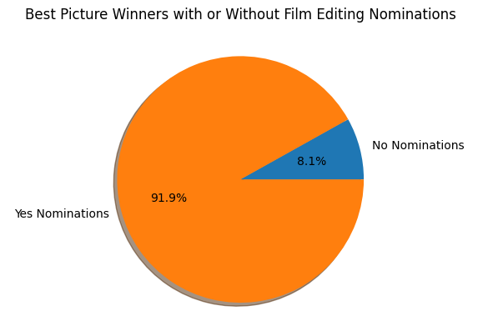
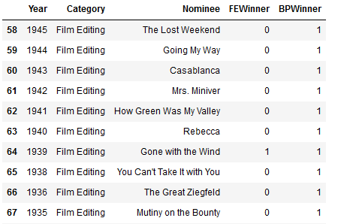
All Time Data
Movies from 1934-2010
Film Editing not a category before 1934
92% of Best Picture winners have been nominated for Film Editing
Data Set

Slide 5
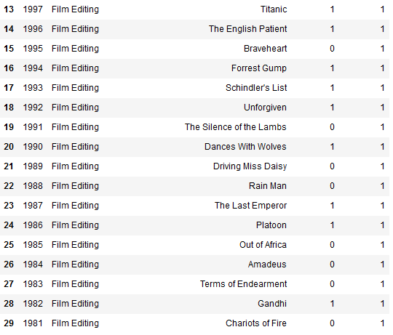
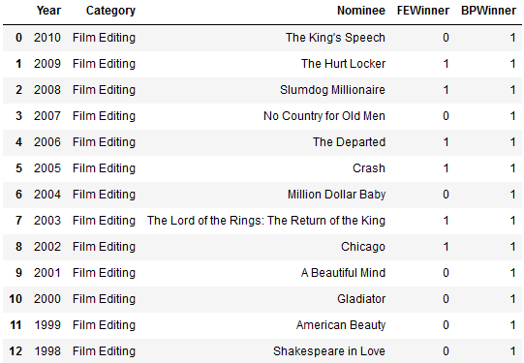
Data Since 1981
*Trend broken only in 2014, 2021
All Best Picture winners since 1981 have been nominated for Film Editing

